Slide 1
Freedom Ecommerce Platform
Andrew Teterycz, Nan Jia, Brent Maccallum

Slide 2
Inspiration
The main inspiration we had for this project was to build something similar to Amazon.
This includes a shopping platform that can handle multiple 3rd party clothing retailers, all focused in the same place.
We focused on making the user interface simple and refreshing, as well as an admin panel with some controls.

Slide 3
Requirements & MVP
Users should be able to browse products, create a cart, add/remove items as necessary and finalize cart.
Admins should be able to create, remove, update and delete products.
Products, Users and Orders should be stored inside a database.

Slide 4
Infrastructure
Frontend: React.js
Backend: Node.js
Package Dependencies:
bcrypt.js - dotenv
express - express-asnyc-handler
jsonwebtoken - mailgun-js
mongoose - multer
nodemon - path
socket.io

Slide 5
Web Page Structure
HomePage
Sign up / Log In
Products
Categories
Shopping Cart
Admin Dashboard

Slide 6
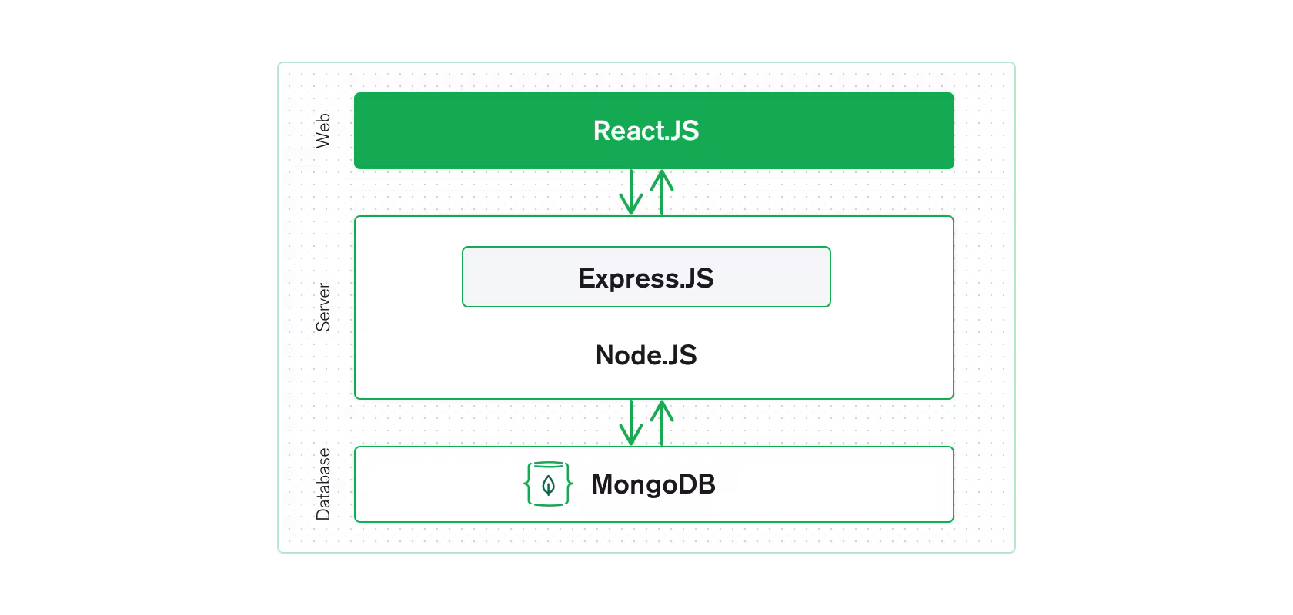
MERN Stack Application
3 Layer Architecture

Slide 7
Sign up & Log in
Our authentication system was built to be used with a database. Users are created and granted an auto-generated ID, as well as a hashed password to ensure user information safety.
Error messages are returned upon login or sign-up dependant on the situation.
There exist three types of users:
Customer
Seller
Admin

Slide 8
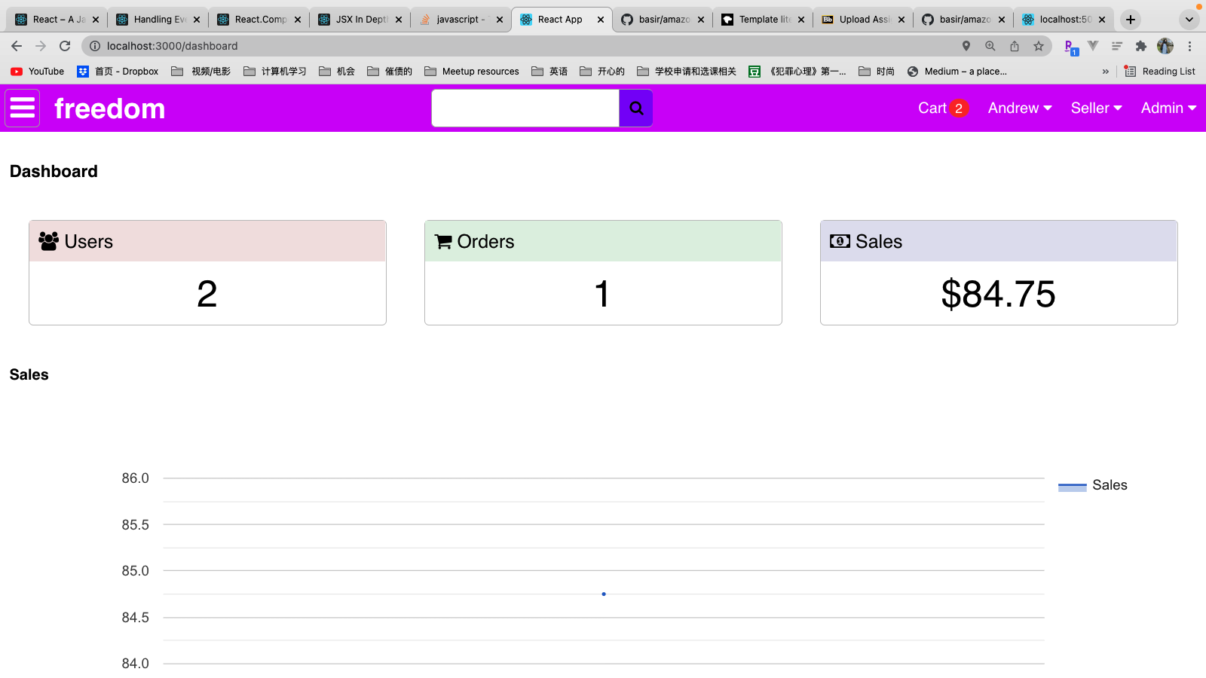
Admin Dashboard

Slide 9
Products
The products handled by the website are currently stock placeholders, as the client company hasn’t yet provided us with the details of the products they will sell. The structure exists to create a webpage for any given product. This is done through the use of a product ID number.
When Products are entered into the database, depending on their category and brand, it will be placed into an existing category. If the category doesn’t exist, a new one is automatically created. This allows for ease of use, reusability and procedural creation of pages on the spot without further input from the developer.
Products are split into categories and brands. They contain a name, image, price, description and reviews.

Slide 10
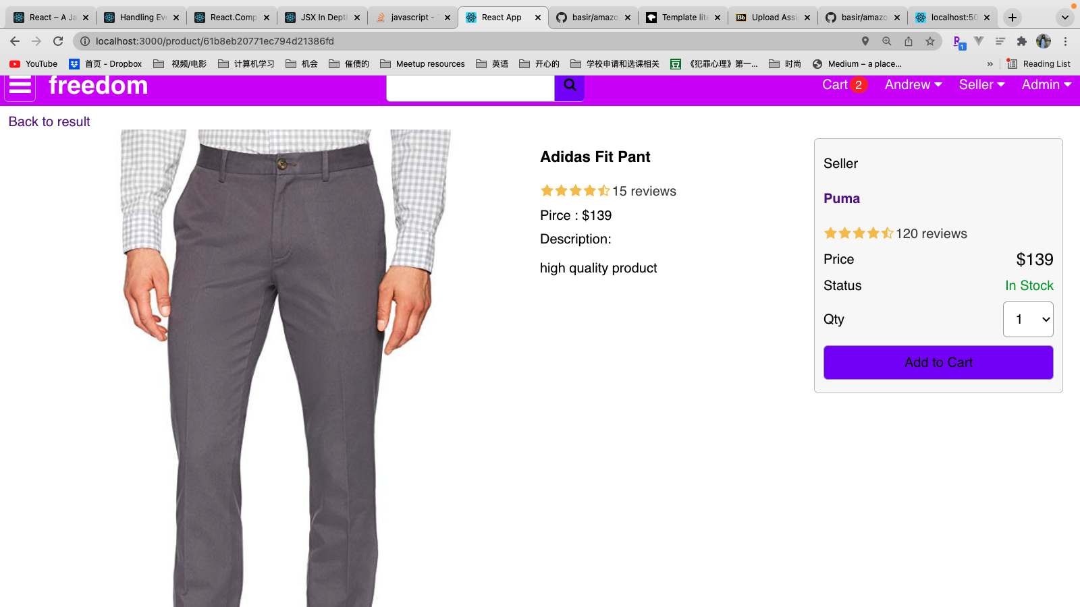

Slide 11
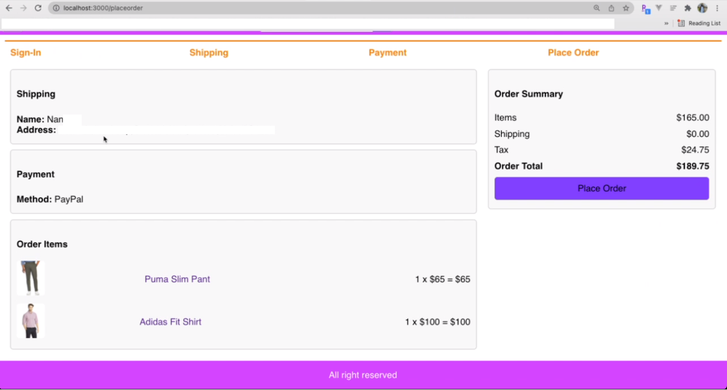
Shopping Cart
The cart is handled by the current session of the web browser.
As long as users are logged in, they are able to add, remove and finalize a cart.
At this point, we have everything functioning except the finalize, as we don’t have a commercial bank account or products to ship.

Slide 12
Testing
Database Manipulation
Product manipulation (user & admin side)
User Interface Responsiveness
Shopping Cart Functionality (Add, Remove)

Slide 13
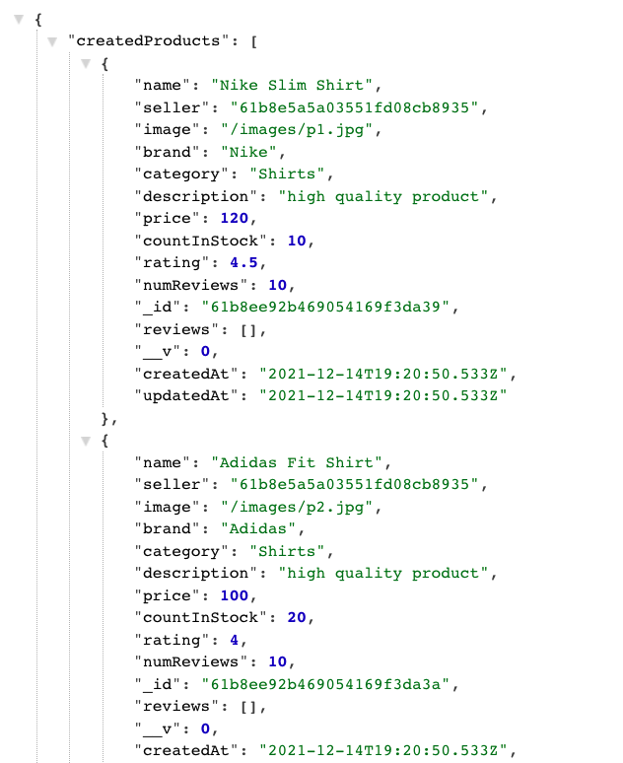
Data Insertion API Example

Slide 14
Future Plans
Steps for a fully complete product:
Commercial bank information from the client company
Details for a system to handle order and traffic flow
Server address and database initialization

Slide 15
Deployment
Once the future plan’s criteria are met, we will be able to fully deploy the product.
A document will be provided with the program that includes details for how to request new additions and revisions to the current program, allowing for future updates.
Our Deployment plan includes launching our website on the Heroku app with help from MongoDB.
Along with revision and additions made, the product will be fully functional and able to handle at least 500 customers at once. This is due to MongoDB & Heroku free version of hosting software. If the client company is willing to upgrade, the processes will be able to handle much more traffic.

